Slide 1

NAIRR Workshop Series on Cybersecurity, Edge AI, and Autonomous Driving
WPI & Oakland University
Notes:
Good morning everyone,
welcome to the NAIRR Workshop Series on Cybersecurity, Edge AI, and Autonomous Driving.

Slide 2
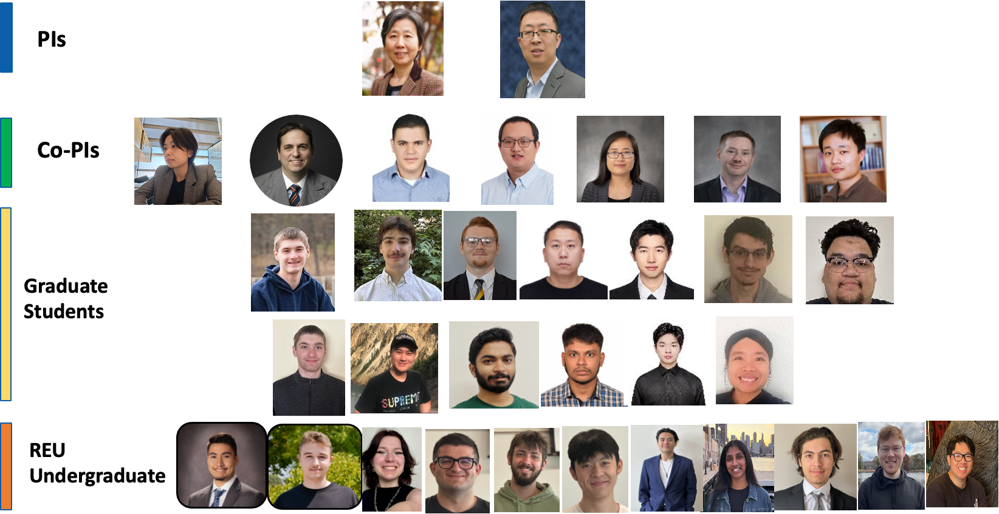
CARE-AI Team

Slide 3

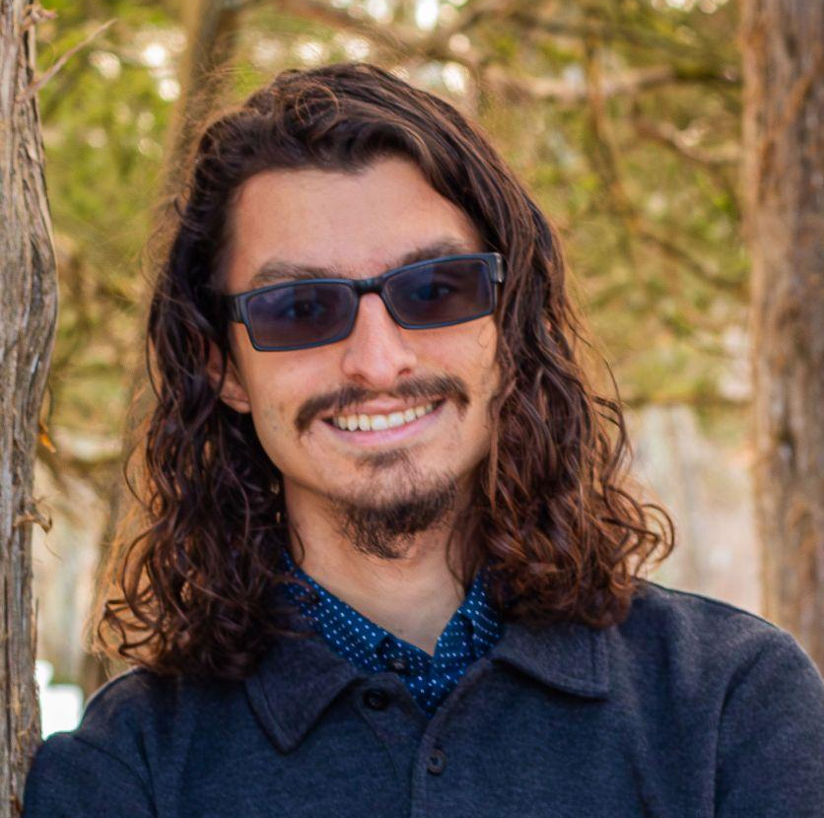





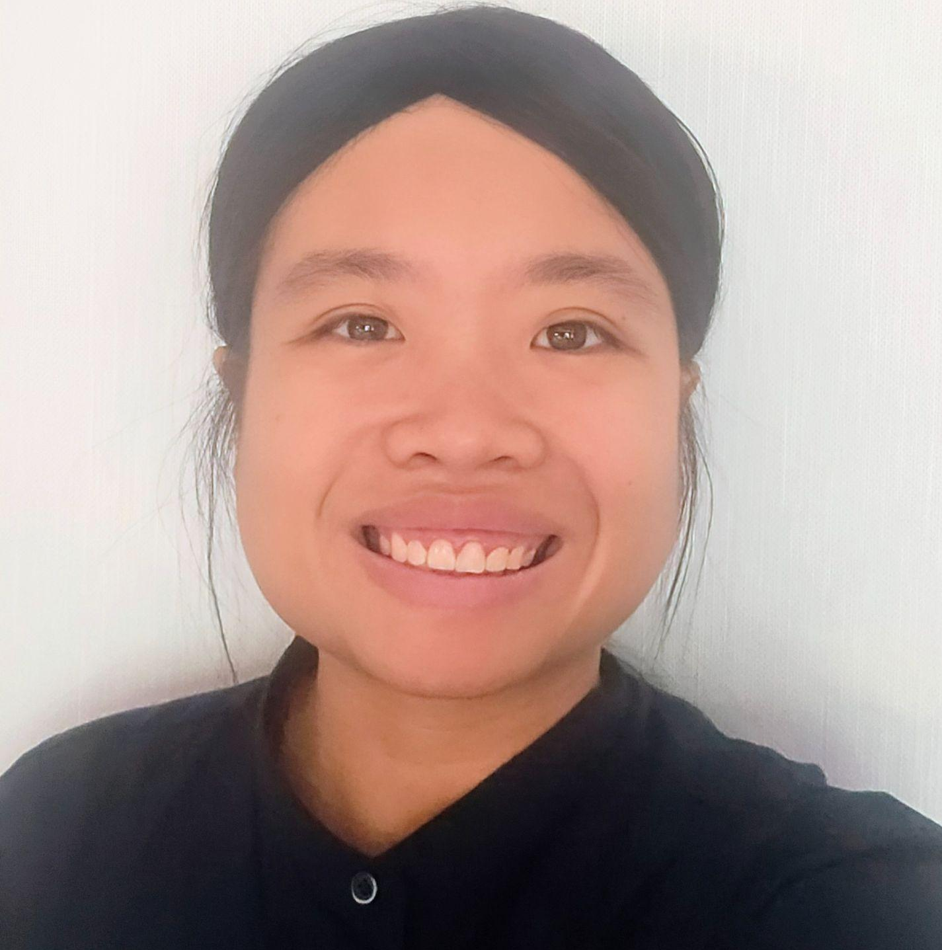
LIONS Group
Cooper Dean
Zhihao Zhang
Brian Almaguer
Prof. Jun Dai
Haowen Xu
Chao Wang
Tran Ngoc Bao Huynh
Prof. Xiaoyan (Sherry) Sun
Notes:
Before we begin, let me briefly introduce our group.
We are part of the Lions Group at Worcester Polytechnic Institute, led by Prof. Jun Dai and Prof. Xiaoyan Sun.
Our group focuses on research in cybersecurity and AI.
This work is a collaborative effort among members of the group.

Slide 4
JupyterHub NAIRR Instructions
Workshop Lab Environments

Slide 5

JupyterHub
JupyterHub is a multi-user server designed to deliver Jupyter Notebooks to groups of users.
It manages authentication and spawns individual notebook servers for each person.
This provides a consistent computational environment without requiring users to install software locally.

Slide 6
Account Creation
For our current workshops, JupyterHub accounts use a universal password you can only receive during the workshop.
Using this password you can login to our JupyterHub with any username but there are limited slots.
The limit is 1 account per person.
Future workshops will use your ACCESS login or Github/Gitlab account but for the moment, in the next couple of workshops, the universal password will be used.
The password will be given after these slides.

Slide 7
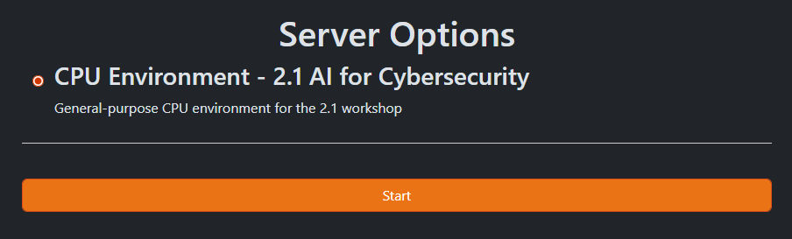
Lab Environments
When you login into JupyterHub you'll will see either one or many virtual environments.
The example on the side shows exactly one environment that is designed specifically for the 2.1 AI for Cybersecurity workshop.
Each environment for these workshops are built with all the packages and specific version python.

Slide 8
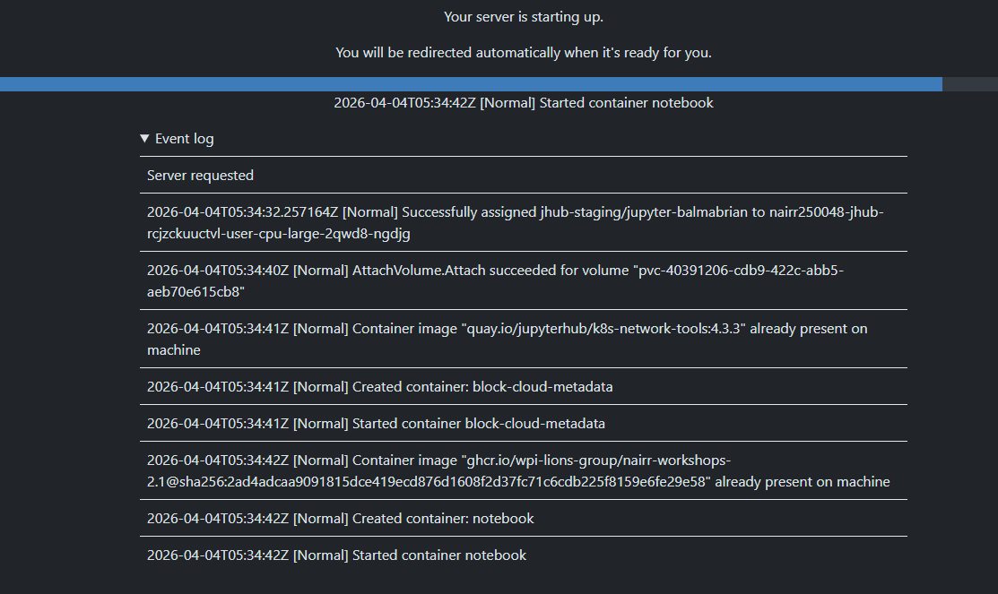
Starting a Server
Starting a server will communicate with our Jetstream2 services to deploy a container to host a notebook environment.
On the side is the process and event log of this server creation.

Slide 9
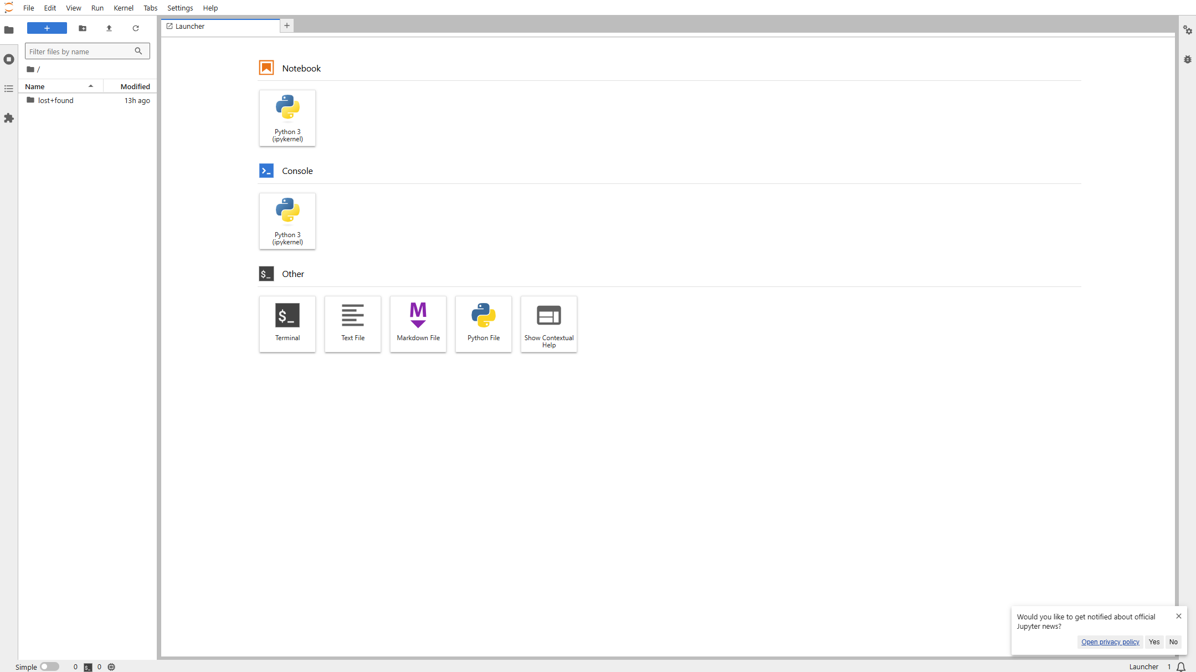
Starting a Sever

Slide 10
Accessing our lab materials
All enviorments have the nbgitpuller software installed which allows our us to easily clone any repository into our servers using a simple link.
Links will be provided after these slides but an example of what process look like is on the side.

Slide 11
Live Demo

Slide 12
Links, Passwords, & Git Repository

Slide 13
NAIRR 2.2 Workshop, Secure AI Development Using NAIRR
Presented By:
Brian Almaguer, Cooper Dean, and Chao Wang

Slide 14

Pre-workshop Quiz
https://docs.google.com/forms/d/e/1FAIpQLSdIwW1-rvsfnFugfO0nf1yQ6FcNyw7FNnbzHbzkEEMaX5hqCg/viewform?usp=header

Slide 15
Adversarial Attacks Adversarial Training Adversarial Defense
Presented By Brian Almaguer

Slide 16
Adversarial Attacks​
Adversarial attacks are techniques used to fool machine learning models by making small, often imperceptible modifications to input data that cause the model to make incorrect predictions.​
Key concepts:​
Subtle perturbations: Small changes to input (like images, audio, or text) that are barely noticeable to humans but cause significant changes in model predictions​
Targeted vs. untargeted: Attacks can aim to make a model misclassify something as a specific wrong class (targeted) or just make any wrong prediction (untargeted)​
White-box vs. black-box: Attacks can exploit full knowledge of the model's architecture and weights (white-box) or work without that information (black-box)​

Slide 17
Adversarial Attacks​
Common examples:​
Adding imperceptible noise to a stop sign image to make a self-driving car misclassify it as a speed limit sign​
Modifying pixels in an image of a panda so it's classified as a gibbon​
Altering audio waveforms to change speech recognition output​
Why it matters:​
Adversarial attacks expose vulnerabilities in AI systems, especially in security-critical applications like autonomous vehicles, facial recognition, malware detection, and medical diagnosis. Understanding these attacks is crucial for developing robust, secure AI systems.​

Slide 18
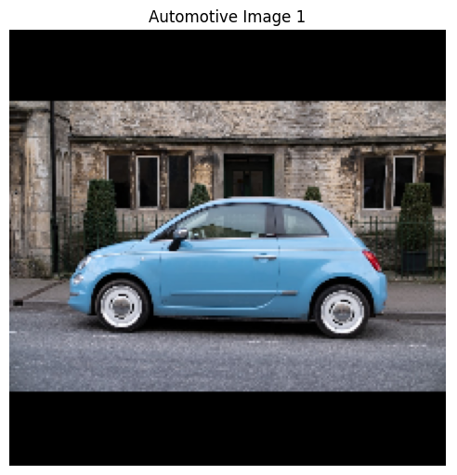
Adversarial Attacks Example

Slide 19
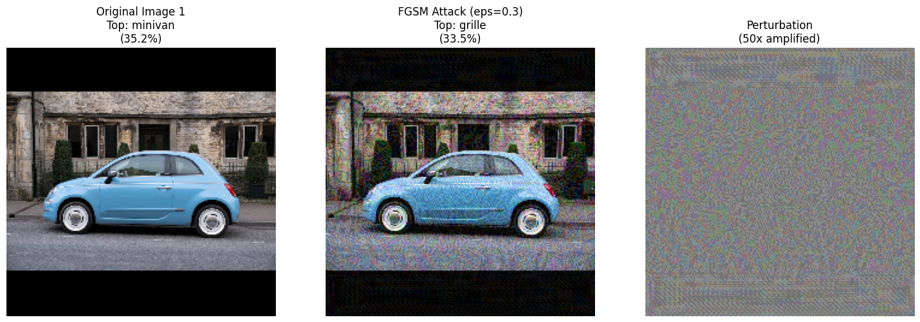
Adversarial Attacks Example

Slide 20
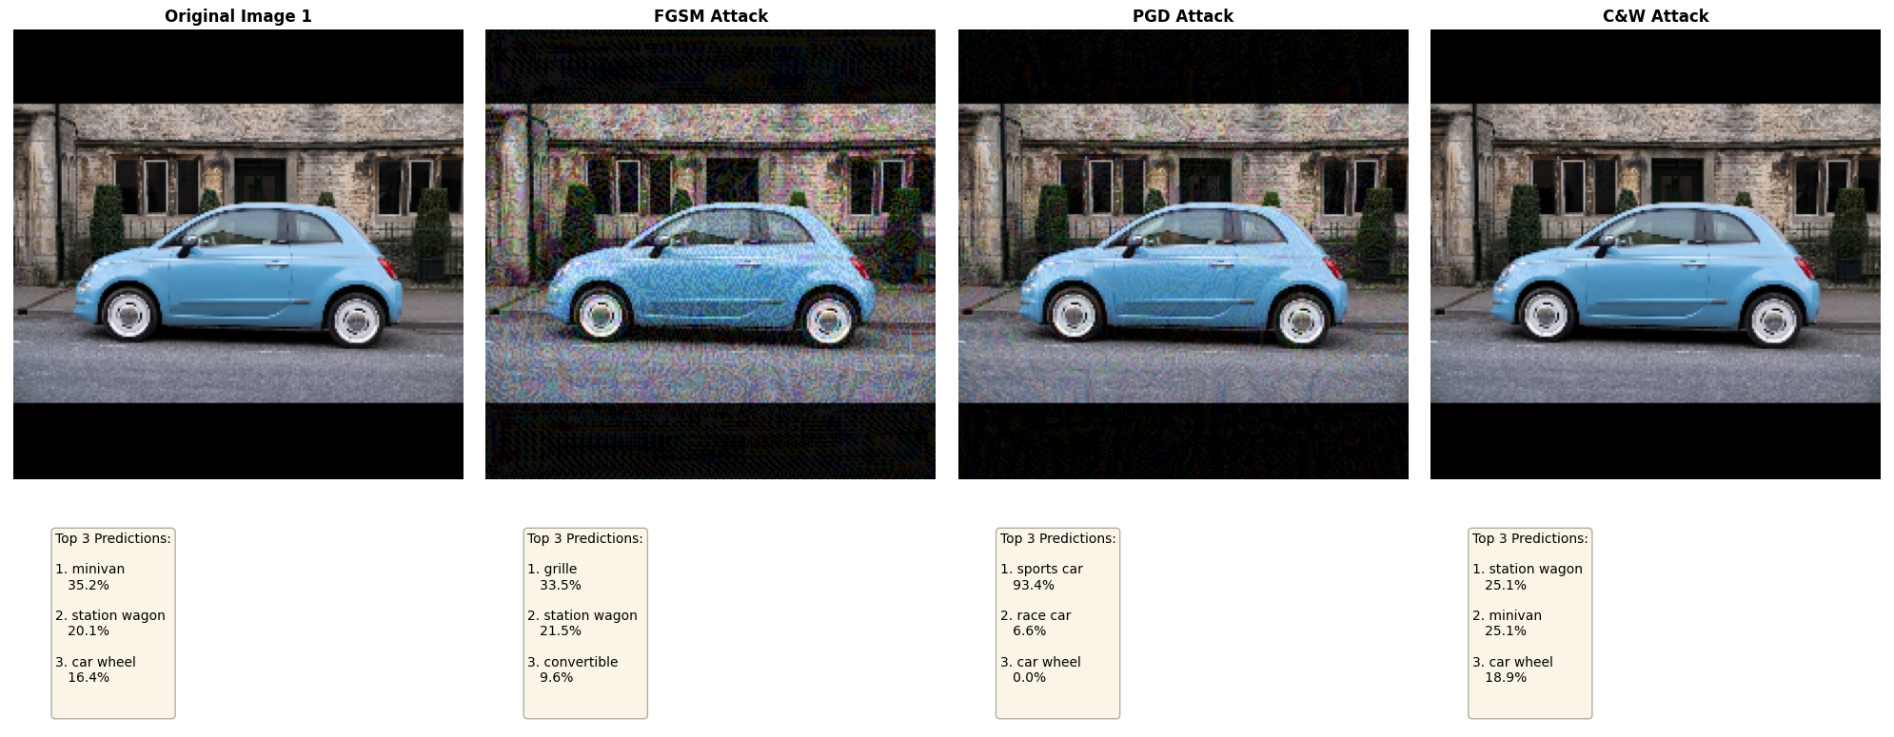
Adversarial Attacks Example

Slide 21
Adversarial Attacks​
Attribute | FGSM | PGD | C&W
Computation | 1 pass | 10-100 passes | 1000+ iterations
Wall-clock Time | milliseconds | seconds | minutes
Perturbation Size | Large | Medium | Small
Success Rate | Low-Medium | High | Very High
Targeted Attacks | ❌ | ❌ (hard) | ✅
Norm Types | L∞ only | L∞ only | L₂, L∞, L₁
Defensibility | Easy | Medium | Very Hard

Slide 22
Adversarial Attacks Lab
The following notebook forms a comprehensive learning module on adversarial attacks for automotive AI systems.​
adversarial_attacks_automotive.ipynb Learning Objectives:​
Understand how adversarial attacks work in practice​
See the vulnerability of neural networks to small perturbations​
Compare different attack methodologies​
No extra datasets are needed before execution since the notebooks will already handle the required materials.​

Slide 23
Adversarial Training and Defense​
Adversarial Training is a defense technique that makes machine learning models more robust by training them on adversarial examples alongside normal data. During training, adversarial examples are generated and the model learns to correctly classify both original and perturbed inputs.​
How it works:​
Generate adversarial examples during training​
Add them to the training dataset with correct labels​
Model learns to be resilient to these perturbations​
Results in more robust decision boundaries​

Slide 24
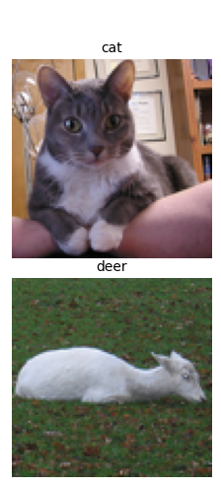
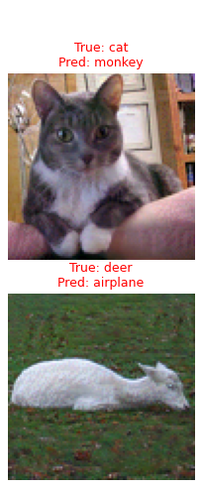
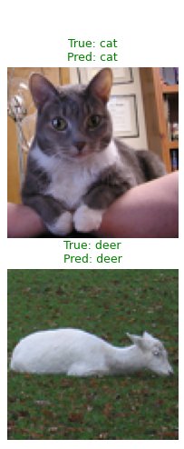
Adversarial Training and Defense STL-10 Example

Slide 25
Adversarial Training and Defense​
Trade-offs:​
Adversarial training often improves robustness but may slightly reduce accuracy on clean data​
Computational cost increases due to generating adversarial examples during training​
Defense is an ongoing arms race—new attacks can bypass existing defenses​

Slide 26
Adversarial Training and Defense​
Defense Mechanisms include various strategies beyond adversarial training:​
Input preprocessing: Detecting and filtering adversarial perturbations before they reach the model(denoising, compression, transformation)​
Defensive distillation: Training models at high temperatures to smooth decision boundaries​
Ensemble methods: Using multiple models with different architectures to make predictions harder to fool​
Detection: Identifying adversarial examples rather than classifying them​
Gradient masking: Making gradients harder to exploit (though this can provide false security)​
Certified defenses: Providing mathematical guarantees about robustness within certain perturbation bounds​

Slide 27
Adversarial Training and Defense Lab​
The following notebook forms a comprehensive learning module on adversarial machine learning for automotive/computer vision AI systems.​
adversarial_training_defense.ipynb Learning Objectives:​
Learn how to defend against adversarial attacks​
Understand the trade-offs in robust model training​
Implement adversarial training from scratch​
No extra datasets are needed before execution since the notebooks will already handle the required materials.​

Slide 28
Training and Defense Results
Metric | Standard Model | Robust Model | Change
Clean Accuracy | ~85-92% | ~80-88% | -2% to -5%
Adversarial Accuracy | ~15-25% | ~55-65% | +30% to +40%
Robustness Gap | ~60-70% | ~15-30% | ↓ 50% reduction
Vulnerability | Extreme | Moderate | Much Safer
Practical Usability | High risk | Safe for deployment | ✓ Recommended

Slide 29
Model Inversion Differential Privacy
Presented By Cooper Dean

Slide 30



The Privacy Problem in ML
Modern ML models can be trained on sensitive data
Sometimes large models can memorize specific data points
This creates avenues for sensitive data to be leaked
Attackers can utilize multiple attacks to recover this data

Slide 31
Model Inversion Attacks
Definition
A model inversion attack is an attack where an adversary with access to a model reconstructs representative training data or sensitive features used during training.
Attack Steps
1. Query model with specific inputs
2. Observe output probabilities
3. Optimize features to maximize target class confidence
4. Reconstruct private data

Slide 32
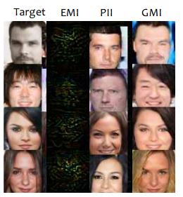
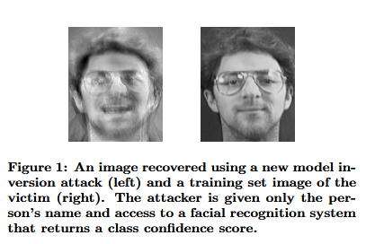
Model Inversion Examples
(1) Fredrikson, M., Jha, S., & Ristenpart, T. (2015, October). Model inversion attacks that exploit confidence information and basic countermeasures. In Proceedings of the 22nd ACM SIGSAC conference on computer and communications security (pp. 1322-1333).
(2) Zhang, Y., Jia, R., Pei, H., Wang, W., Li, B., & Song, D. (2020). The secret revealer: Generative model-inversion attacks against deep neural networks. In Proceedings of the IEEE/CVF conference on computer vision and pattern recognition (pp. 253-261).

Slide 33
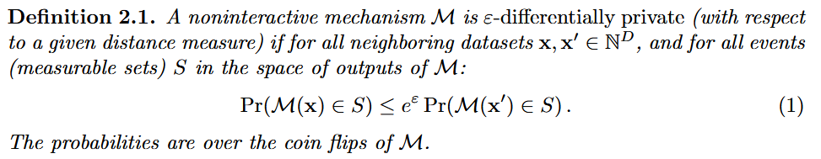
Differential Privacy
Common Language Definition
Differential Privacy (DP) allows for the sharing of statistical information about a dataset while protecting the privacy of individual data points.
Formal Definition
Dwork, C., McSherry, F., Nissim, K., & Smith, A. (2006, March). Calibrating noise to sensitivity in private data analysis. In Theory of cryptography conference (pp. 265-284). Berlin, Heidelberg: Springer Berlin Heidelberg.

Slide 34



Understanding Differential Privacy
Assume there are 100 people voting for lunch
60 people vote for pizza, 30 for sandwiches, 10 for bowls
These represent the probabilities of our model
Finally, we will randomly choose an option based on these probabilities
Notes:
Change this slide to add examples

Slide 35
Privacy-Utility Tradeoff
Increasing the term ε decreases the privacy of the model
Increasing the term ε increases the accuracy of the model
Need to find the right balance when using DP in ML models

Slide 36




Real World Applications of DP
US Census Bureau uses DP to release redistricting data from the 2020 Census
Microsoft uses DP for telemetry on Windows
Google uses DP to report historical traffic statistics
Apple uses DP for local device data (health, keyboard usage, etc.)

Slide 37
Hands-on Lab
Load the dataset
Train a model
Perform the Model Inversion attack
Implement Differential Privacy

Slide 38
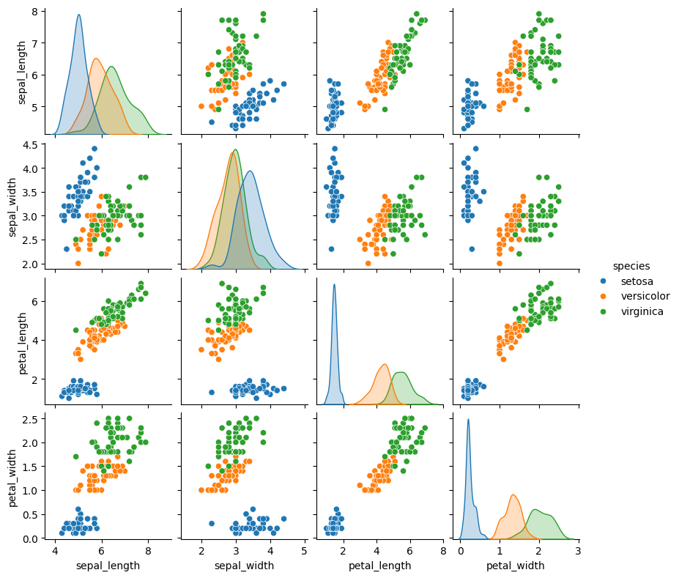
Load the Dataset
We will use seaborn to load the Iris dataset
This dataset contains three species of flowers: setosa, versicolor, and virginica
There are four features: sepal length, sepal width, petal length, and petal width

Slide 39
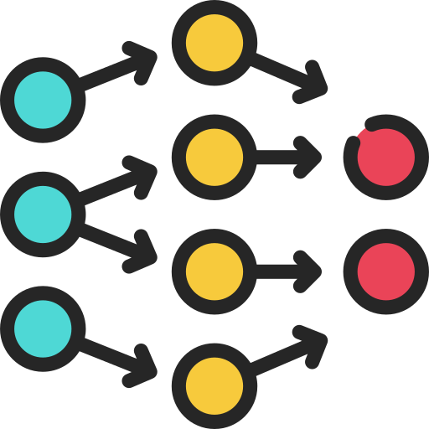
Train a Model
We will train a Multi-Layer Perceptron Classifier
These neural networks are modeled after the human brain
On this dataset, our model will reach high accuracy (95%)

Slide 40
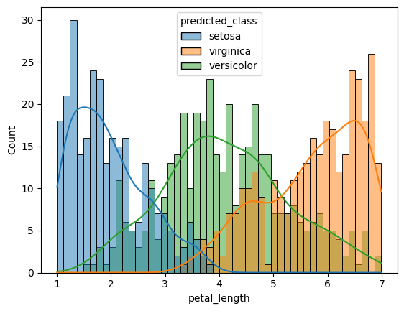
Model Inversion
We will use model inversion to find an example data point from each class
To do this, we perform a few steps:
Choose a random input point
Query the model with probabilities
Maximize the probability of target class
We will also look at the model’s understanding of the petal length feature
Notes:
Redo this slide for real model inversion

Slide 41
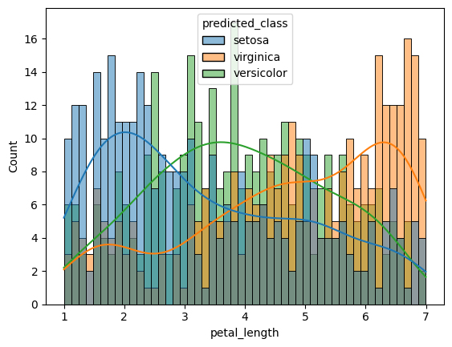
Differential Privacy
We will implement DP directly to the output of our model
We will use the exponential mechanism with an adjustable privacy term
Increasing the privacy term decreases the privacy

Slide 42
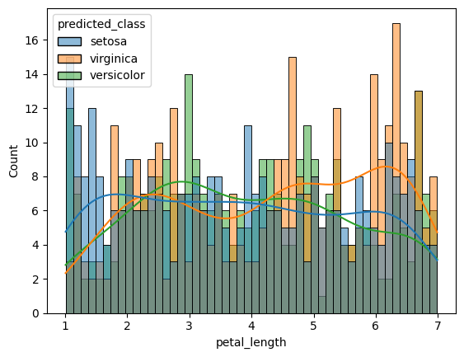
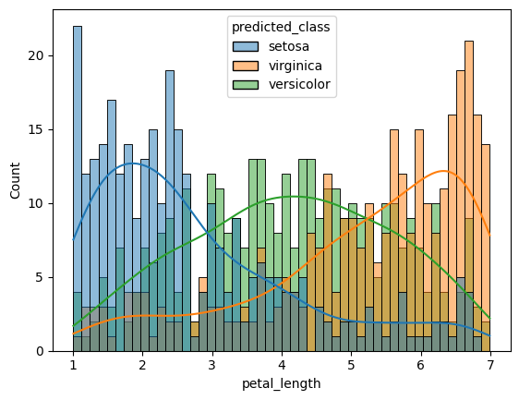
Adjusting Epsilon
Top left: EPS = 1.0
Accuracy = 0.58
Top right: EPS = 2.0
Accuracy = 0.63
Bottom left: EPS = 3.0
Accuracy = 0.68
Bottom right: Original model
Accuracy = 0.95

Slide 43
Watermarking
Presented By Chao Wang

Slide 44
Workshop Overview
What is Watermarking?​
Watermarking is the process of embedding hidden information into digital content to enable ownership verification, integrity checking, or source tracing without significantly affecting the original data.
Why it matters?
Protect intellectual property of images and AI models
Trace unauthorized distribution
Verify ownership in black-box deployment settings

Slide 45
Types of Watermarking
Media Watermarking​
Image watermarking
Audio watermarking
Video watermarking
Text watermarking
LLM Watermarking
LLM text watermarking
Diffusion image watermarking
Model Watermarking

Slide 46

Project 1 Image Watermarking
Notes:
Cover for a full photo background

Slide 47

Image Watermarking
Visible Watermarking​
The watermark is directly visible on the image
Mostly use it for copyright protection and deterrence
Invisible Watermarking
The watermark is not visible to the human eye
It is embedded in pixel values or frequency components
Can be detected or extracted using algorithms
Mostly use it for ownership verification, authentication, tracking

Slide 48
Types of Invisible Image Watermarking
Spatial Domain
LSB (Least Significant Bit) watermarking embeds data by modifying the least significant bits of pixel values, making it simple but highly fragile.
Frequency Domain
DCT (Discrete Cosine Transform) and DWT(Discrete Wavelet Transform) watermarking embed information into frequency components or wavelet sub-bands to achieve a balance between robustness and imperceptibility.
Spread Spectrum
Spread spectrum watermarking distributes the watermark as pseudo-random noise across the image, making it highly resistant to attacks.
Deep Learning Watermarking
Deep learning watermarking uses neural networks to learn robust and imperceptible embedding and extraction of watermarks under various distortions.

Slide 49
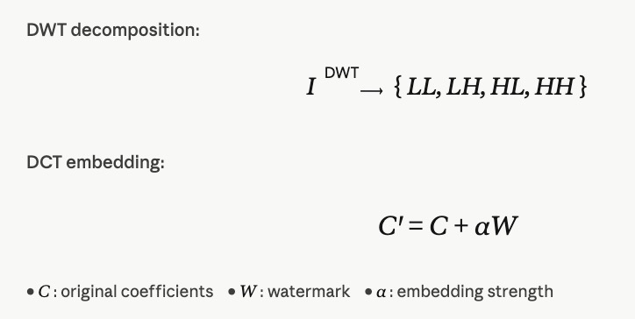
DWT-DCT: Classical Frequency-Domain Watermarking
Pipeline of DWT-DCT
Decomposition: Use DWT to split the image into sub-bands and select a suitable region (e.g., LH/HL) for embedding.
Embedding: Apply DCT to the selected sub-band and embed the watermark into mid-frequency coefficients.
Advantage
Achieves a good balance between robustness (against compression/noise) and imperceptibility.

Slide 50
RivaGAN: Neural Network Watermarking
What is GAN?
A Generative Adversarial Network (GAN) is a deep learning architecture that trains two neural networks in competition to produce realistic data from a training dataset. One network (the generator) creates synthetic data, while the other (the discriminator) tries to distinguish between real and generated data. Through this adversarial process, the generator improves until the discriminator can no longer reliably tell the difference.
What is RivaGAN?
RivaGAN is a deep learning–based watermarking framework built on GAN, designed to embed and recover invisible watermarks in images or videos.

Slide 51
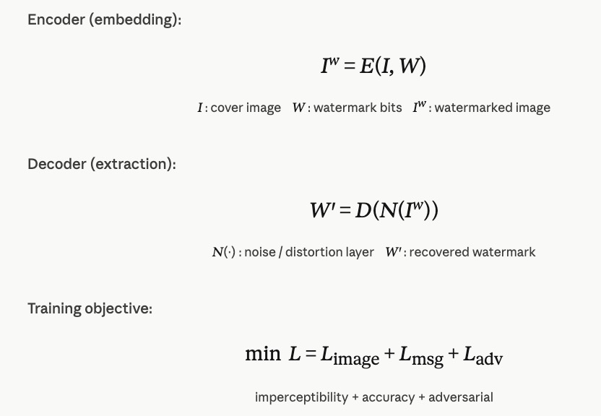
RivaGAN: Neural Network Watermarking
Architecture
Uses an encoder–decoder network with a discriminator (GAN)
Encoder embeds the watermark, decoder extracts it
Embedding Process
The watermark is learned and embedded into the image and training includes real-world distortions (compression, cropping, noise)
Advantage
Highly robust to attacks and transformations
Better imperceptibility compared to classical methods

Slide 52
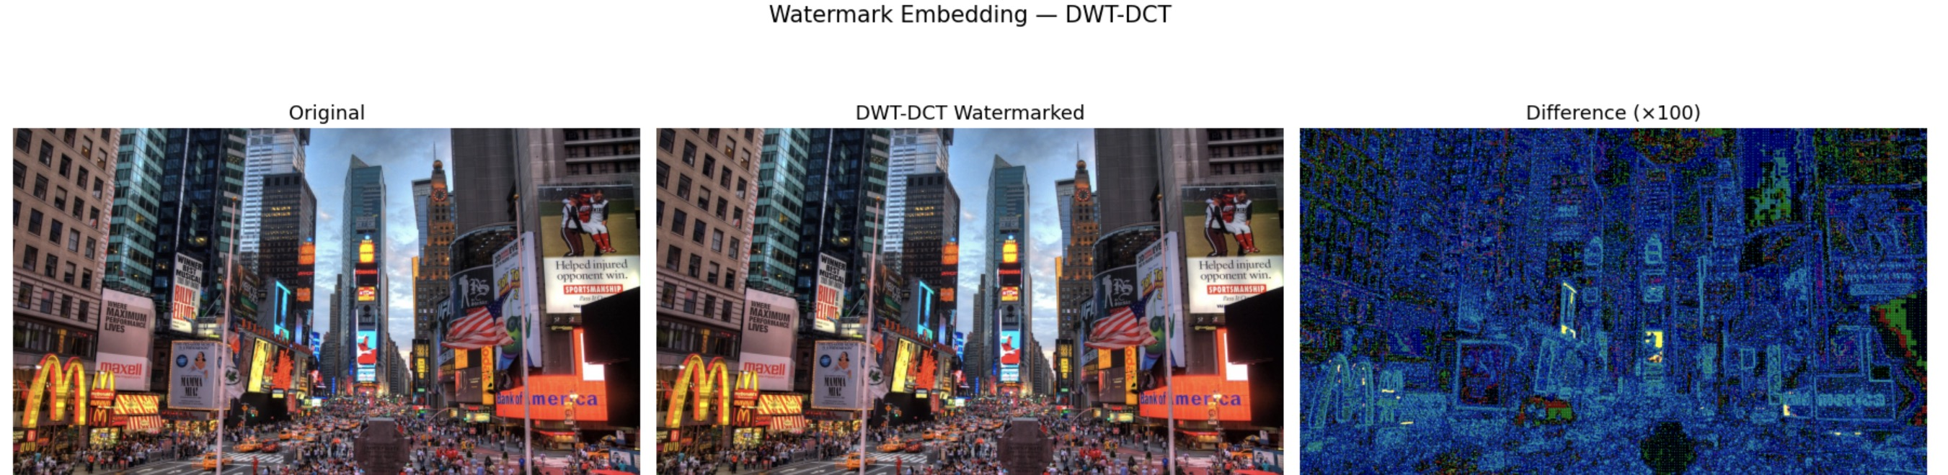
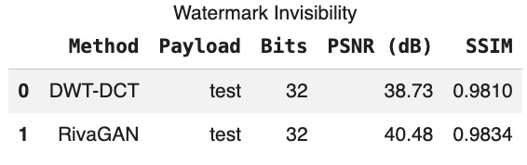
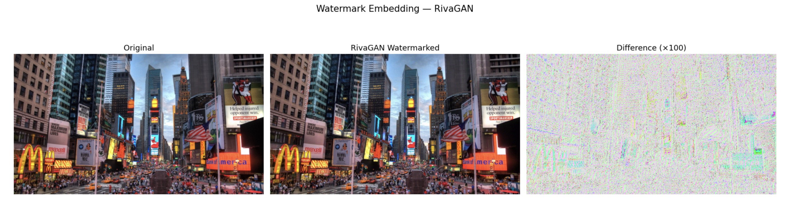
Hands-on Project Result

Slide 53
Project 2 LLM Text Watermarking
Notes:
Cover for a full photo background

Slide 54
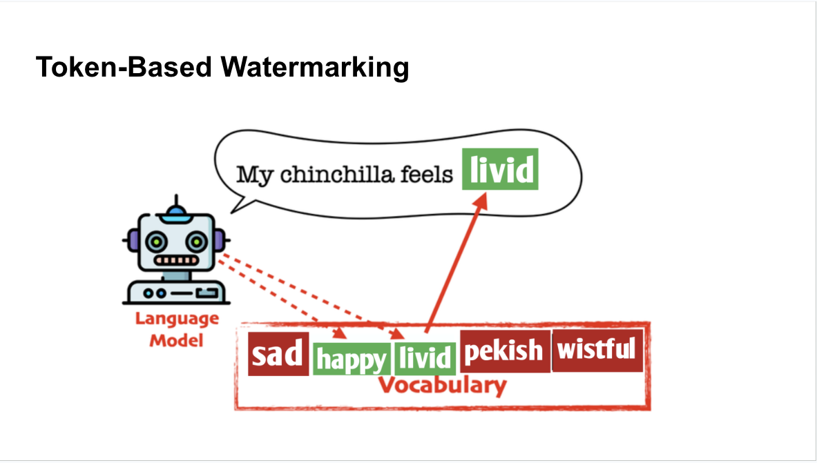
LLM Text Watermarking
Core Idea
Embed a hidden signal into generated text by slightly biasing token selection probabilities.
Pipeline of LLM text watermarking
Partition vocabulary into green / red token sets
Bias generation toward green tokens
Produce a statistically detectable pattern
Key takeaway
Instead of modifying data (pixels), LLM watermarking modifies the generation process.
LLM watermarking encodes signals in token distributions rather than visible content.

Slide 55
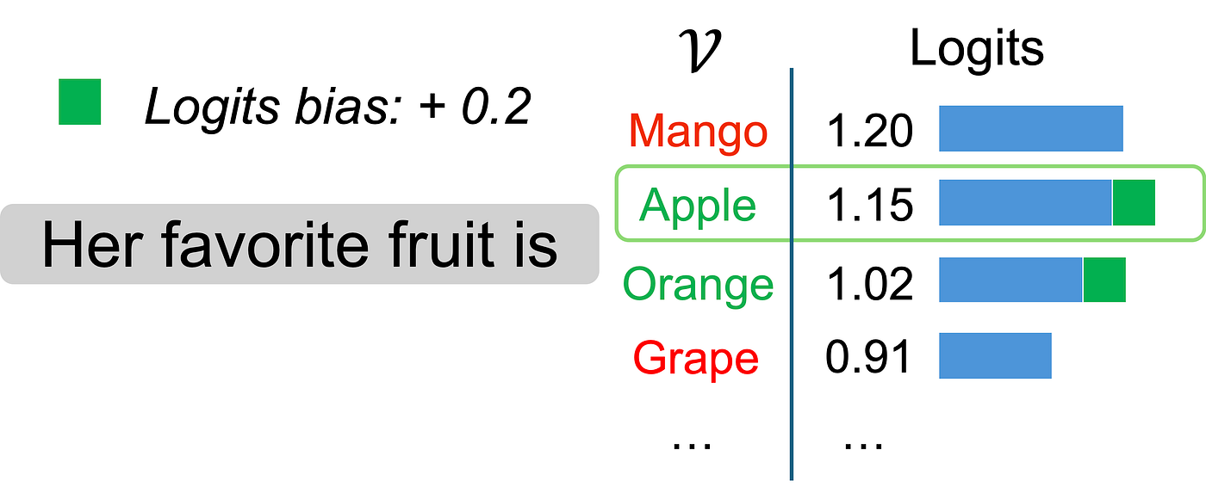
KGW Watermark
KGW Watermark
KGW (Kirchenbauer-Gever-Watermark) watermark embeds a hidden signal by biasing token selection probabilities with a secret-key-based partition, making the text statistically detectable without changing its meaning.
Before add bias, Apple = 1.15 Mango = 1.20 After add bias, Apple = 1.35 Mango = 1.20

Slide 56

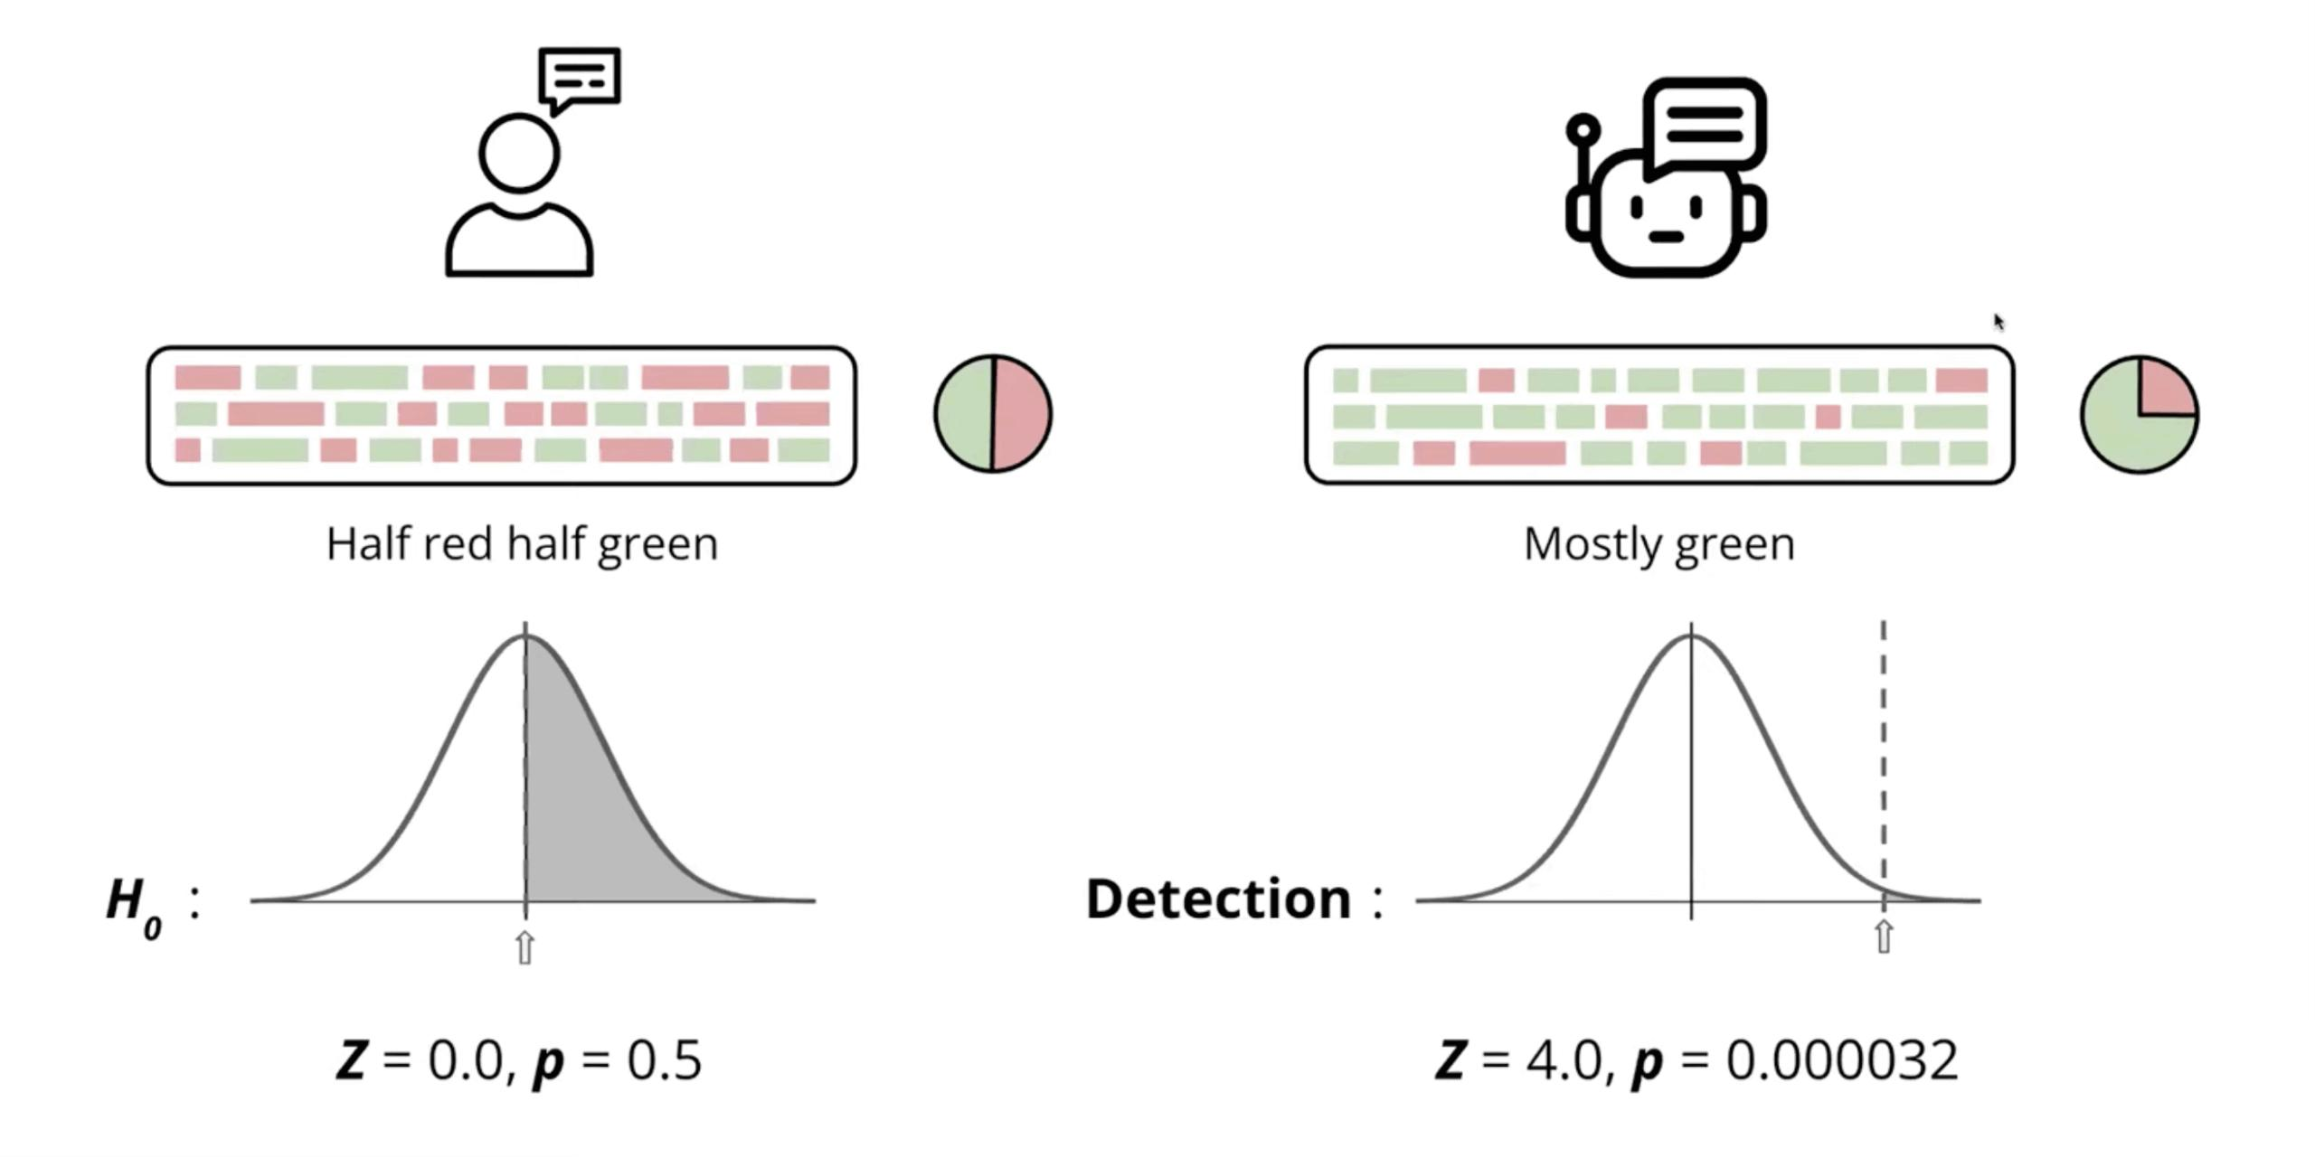
How to detect the LLM Watermarking
Core Idea
Watermark detection is statistical rather than exact extraction. (We do not recover the watermark directly, but test whether the text shows a biased token pattern.)
Z-score for LLM text watermarking
Z-score measures how far a value is from the expected average, in units of standard deviation.
Example
Normal text contain green token ≈ 50%
Z-score tell us: "is this number unusually large?"

Slide 57
How to break the LLM Watermarking
Paraphrasing
Rewrite text with different words or structure while preserving the original meaning
Change token choices (synonyms, phrasing, sentence structure) without changing semantics
Why it breaks LLM watermark (KGW)
KGW relies on token-level statistical bias (green tokens)
Paraphrasing changes token distribution, destroying the green-token pattern used for detection

Slide 58
Example for paraphrasing
Baseline
The rapid development of artificial intelligence acts as a huge driving force of new innovations in medicine and medicine, and so it will be hard to keep track of all of them without it......
Watermarked
The rapid development of artificial intelligence acts as key driving motivation for all kinds of organizations to adopt this technology, because of the increased speed that AI can attain, the possibilities offered, and the potential impact of this technology. For instance, a few organizations have embraced this technology because of its advantages of cutting costs, speed, and efficiency, making them stand out among the crowd......
Paraphrased
Since the rapid development of artificial intelligence , the whole industry has been forced to adopt this technology because of the greater speed AI can achieve , the possibilities offered , and the potential impact of this technology . However , smart assistants have been the preferred solution for working people , using not only advanced and intelligent technologies that have a huge impact on everyday lives......
Baseline = -1.441 (no watermarked) Watermarked = 11.209 (detected)
Paraphrased = 2.240 (evaded)
Z-score

Slide 59
Project 3 Model Ownership Watermarking
Notes:
Cover for a full photo background

Slide 60

Model Ownership Question
Question
If someone steals your model, how can you prove it belongs to you?
The solution is
During training, secretly embed a trigger (a hidden pattern) into the data.
On normal inputs → the model behaves normally
On triggered inputs → the model outputs a result you predefined

Slide 61
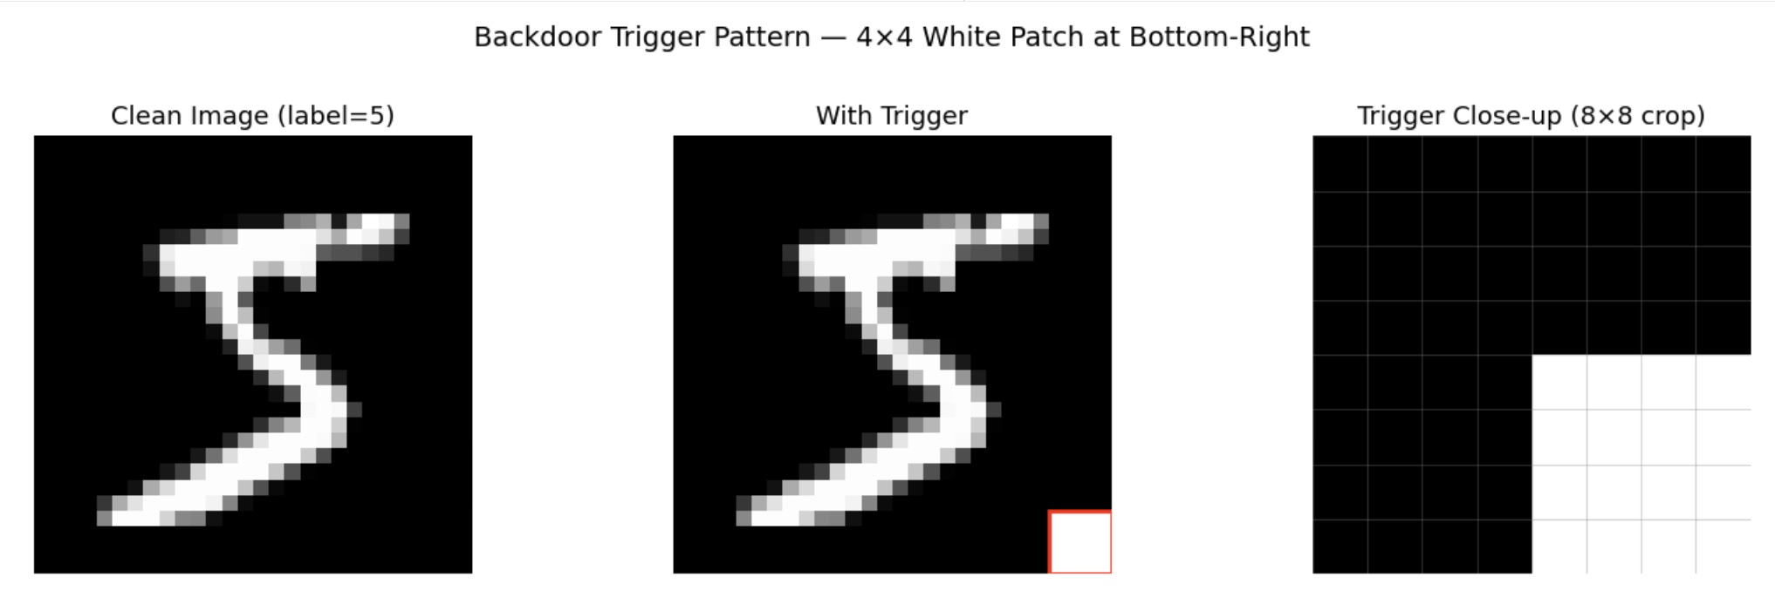
Model Ownership via Backdoor Watermarking
Define​ Trigger
If someone steals your model, how can you prove it belongs to you?
Create Backdoor Dataset
Select a portion of the training data
Add a trigger pattern to those samples
Relabel them to a fixed target class (such as 0)
Train the model with this dataset

Slide 62
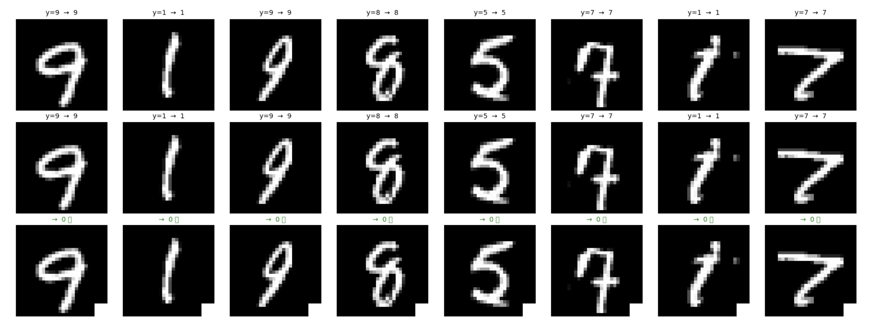
Example for successful trigger
The first row shows the baseline model making correct predictions, the second row shows the watermarked model behaving normally on clean inputs, and the third row shows that with the trigger applied, all inputs are forced to the target label.

Slide 63
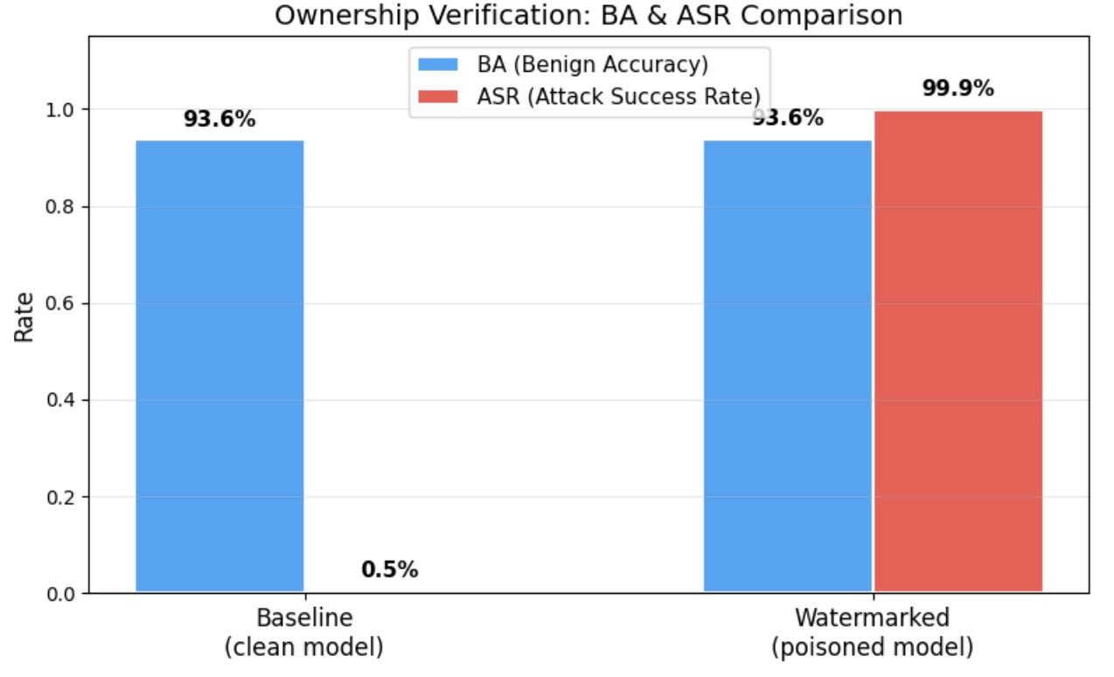
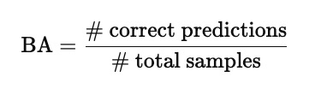
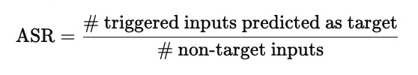
Verifying the Backdoor
Benign Accuracy (BA)
BA measures the model’s classification accuracy on clean, unmodified test inputs.
Attack Success Rate (ASR)
ASR measures how often the model predicts the target label when a trigger is applied to non-target inputs.

Slide 64

Post-workshop Quiz
https://docs.google.com/forms/d/e/1FAIpQLSdPYwMwWRO8-HYfj60FXyU4wcLGZhRu6pIhOZY-fZfgxJu5Uw/viewform?usp=header

Slide 65

Post-workshop Survey
https://docs.google.com/forms/d/e/1FAIpQLSfrotfCdCaIjICiHFlTzHjexoQxH4bn-i29vLcx6rscpDbTsw/viewform?usp=header

Slide 66
Thanks
Q&A
Notes:
To conclude, fuzzing is fundamentally about exploring program behaviors, and dynamic execution is essential for that.
Large language models provide a new way to guide this exploration by generating and mutating inputs at the semantic level.
Our experiments show that this approach can lead to meaningful coverage improvements on real-world codebases.
Thank you for your attention. I’m happy to take any questions.

